Slide 1

KPL “660A EMBLEM” Insights

Slide 2
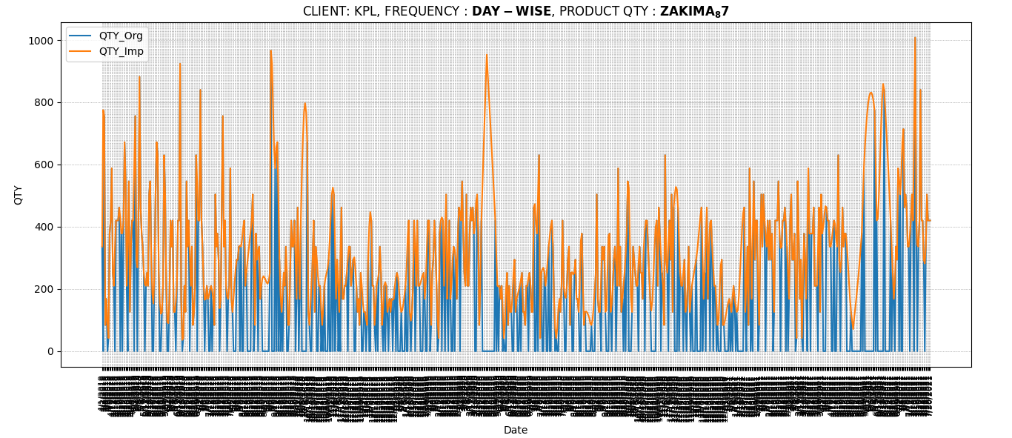
Before Prediction
Blue indicates original data on day frequency.
Orange indicates Akima imputed data on day frequency.
3

Slide 3
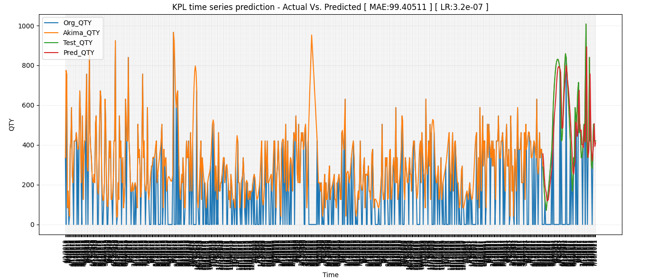
Prediction Window size 10
Prediction with deep learning technique on Imputed data _ Window size 10
3

Slide 4
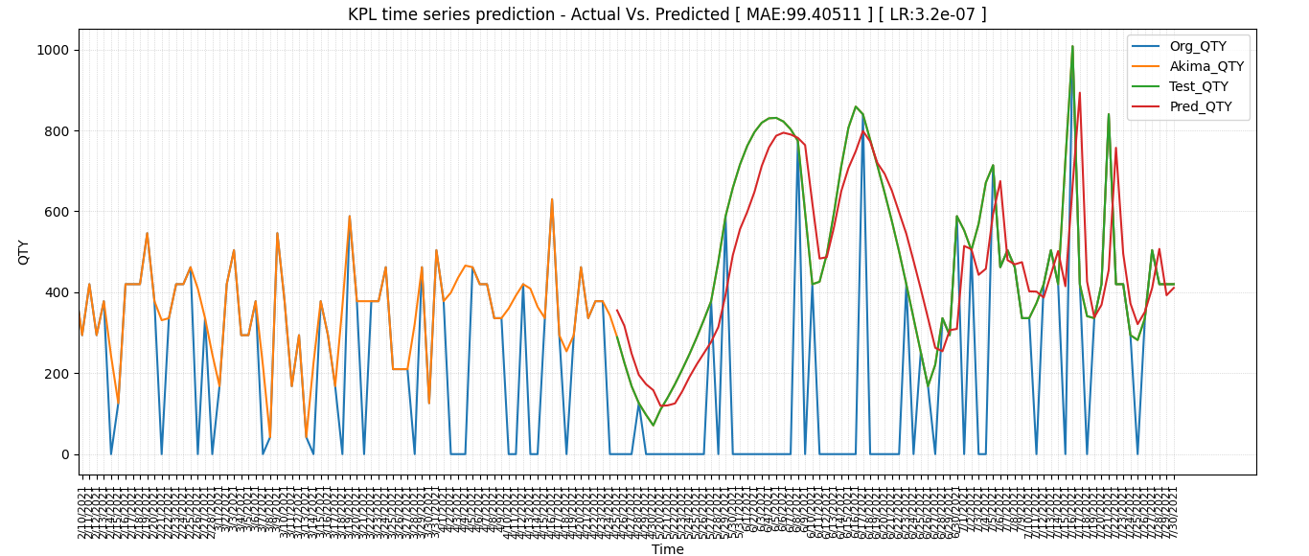
Prediction Window size 10
Previous image scaled to prediction period _ Window size 10
3

Slide 5
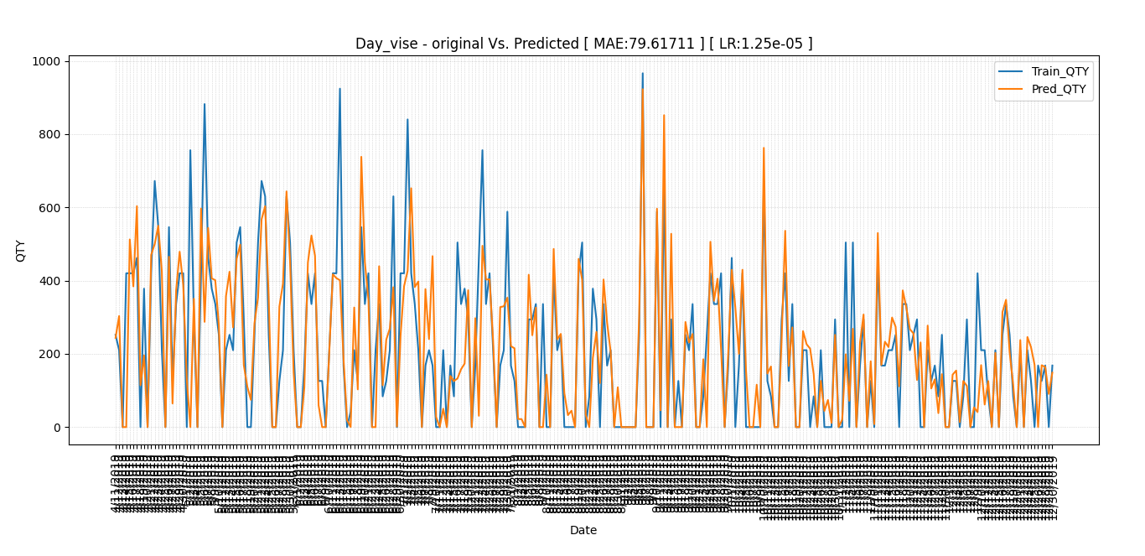
Prediction Window size 10
Prediction before Covid against original data.
3

Slide 6
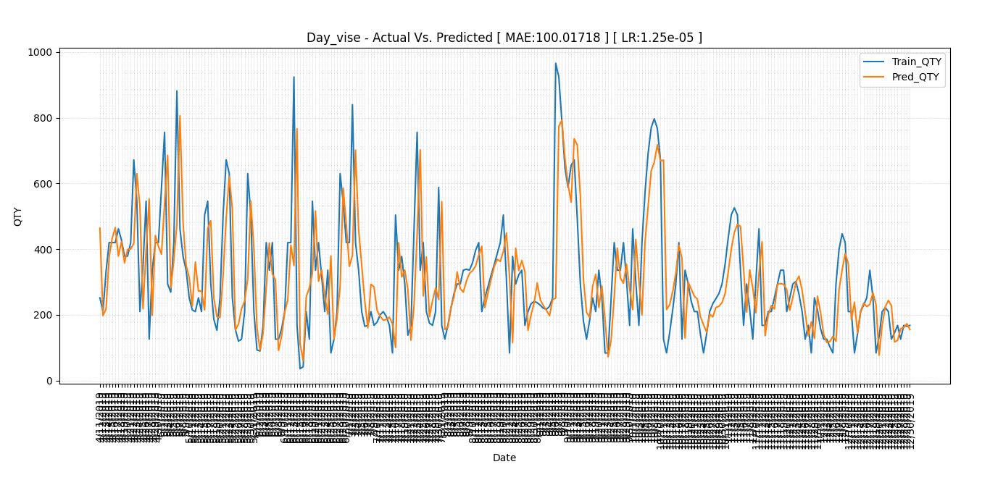
Prediction Window size 10
Prediction Before Covid - Akima Imputed-Window size 10
3

Slide 7
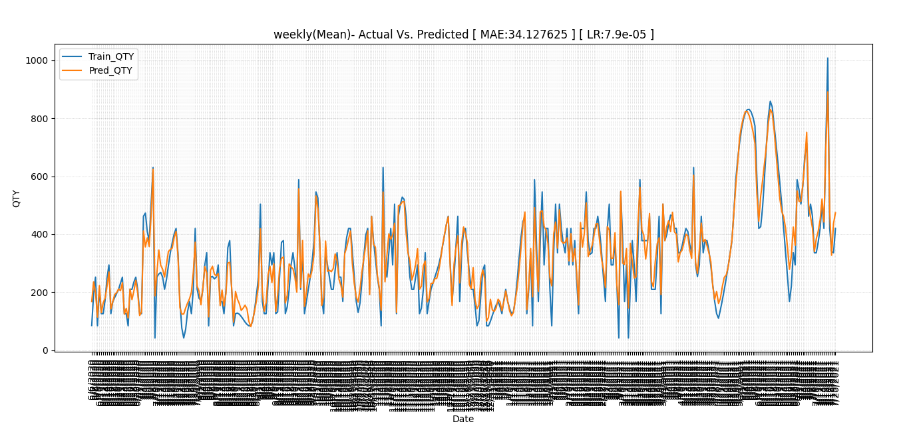
Prediction Window size 10
Prediction After Covid- Akima Imputed-Window size 10 (Daily)
3

Slide 8
Insights of “FGAS-660A-16-00087”
3

Slide 9
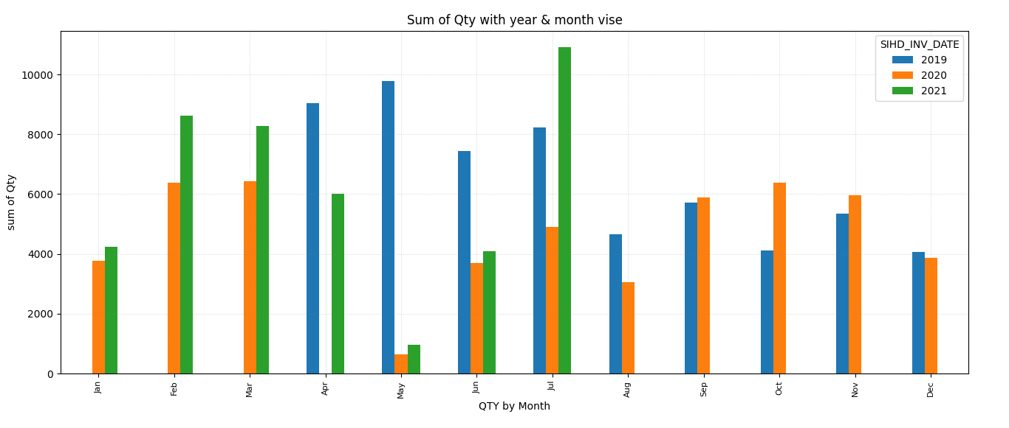
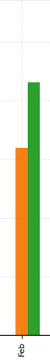
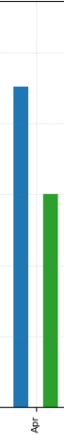
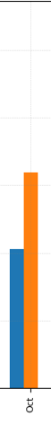
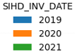
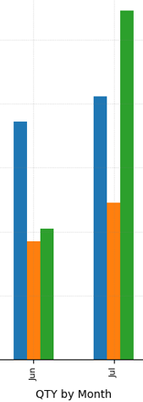
“FGAS-660A-16-00087 ”
660A EMBLEM, BACK DOOR NO.1
Expected
Availability
YEAR | Data Availability |  | Preprocessing Insights
2019 | April | Dec | At this duration data is missing from the month of January 1st week to April 13th week. As we can see at data availability ranges between “April’19 to December’19”. This is the only year where we don’t have any intrusion Covid bias as per the available data.
Week | 14th | 52nd
2020 | Jan-Mar | Jun-Dec | At this time period data there is “no data availability”/”Zero” between April 13th Week to May 21st week. Here missing data represents there is no sales activity due to lockdown imposed because of Covid intrusion. Later 21st week from the month of June sales activity resumed for this particular product.
Week | 1st-12th | 22nd-52nd
2021 | Jan-May | Jun-Aug | For this time period the data availability ranges between Jan 2021 to Aug 2021. Data is Zero in between May 19th Week to June 21st week caused by Covid intrusion. Later 31st week from the month of August sales activity is missing for this particular product.
Week | 1st-18th | 22nd-31st
2

Slide 10
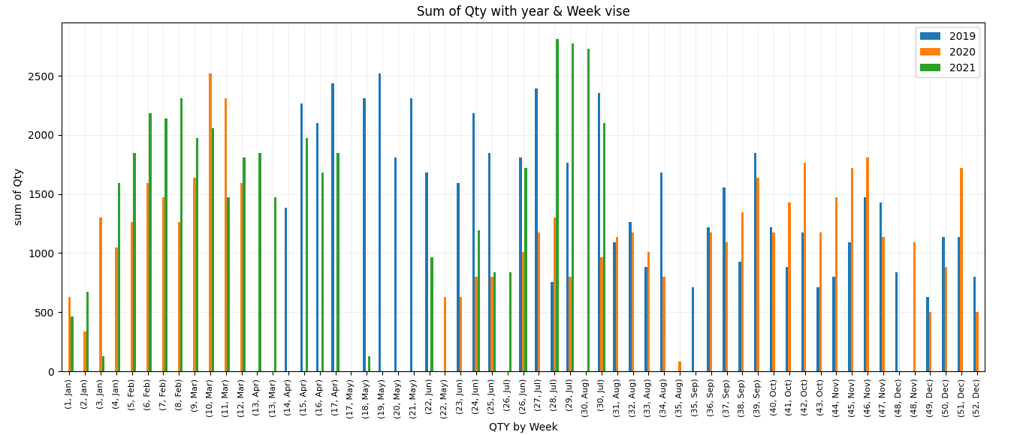
“FGAS-660A-16-00087 ”
660A EMBLEM, BACK DOOR NO.1
2

Slide 11
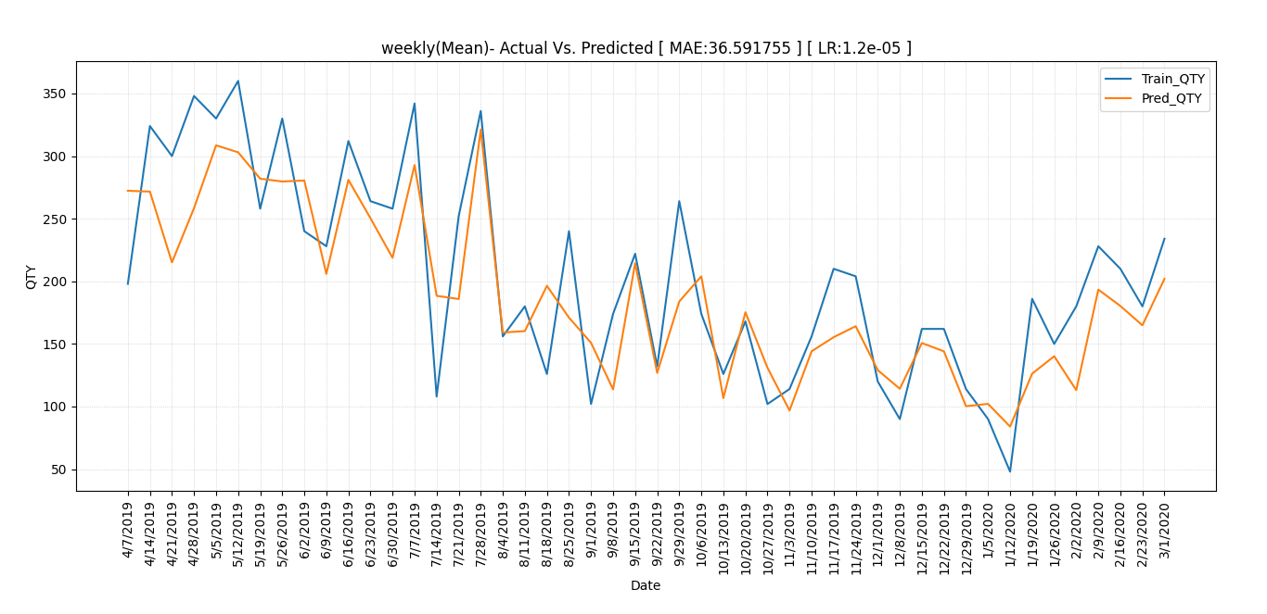
Prediction Window size 4
training | 48
Predicted | 48
Prediction using original data before Covid (Weekly mean)

Slide 12
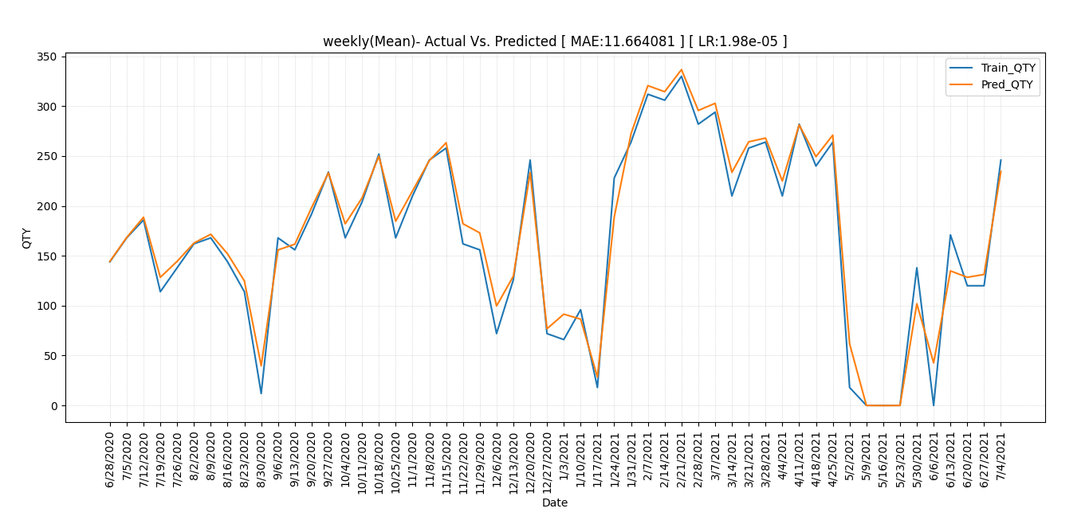
Prediction Window size 4
training | 54
Predicted | 54
Prediction using original data after Covid (Weekly mean)

Slide 13
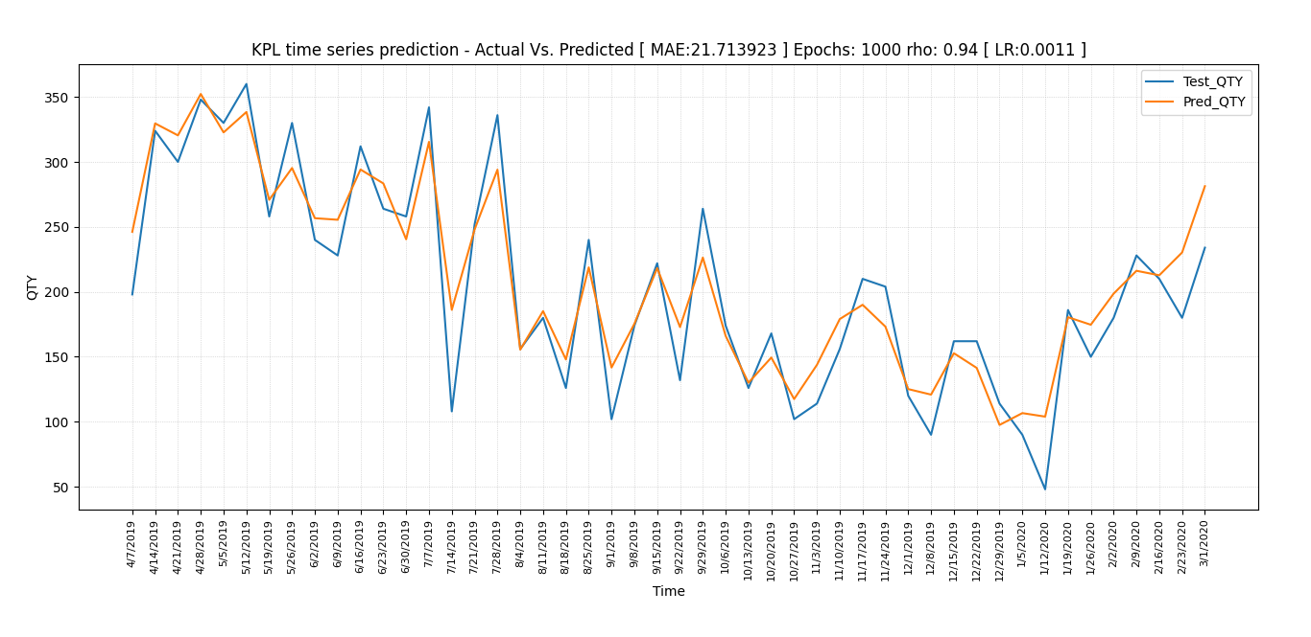
Prediction Window size 3
training | 48
Predicted | 48
Prediction before Covid-Original-Window size 3 (Weekly Resample)

Slide 14
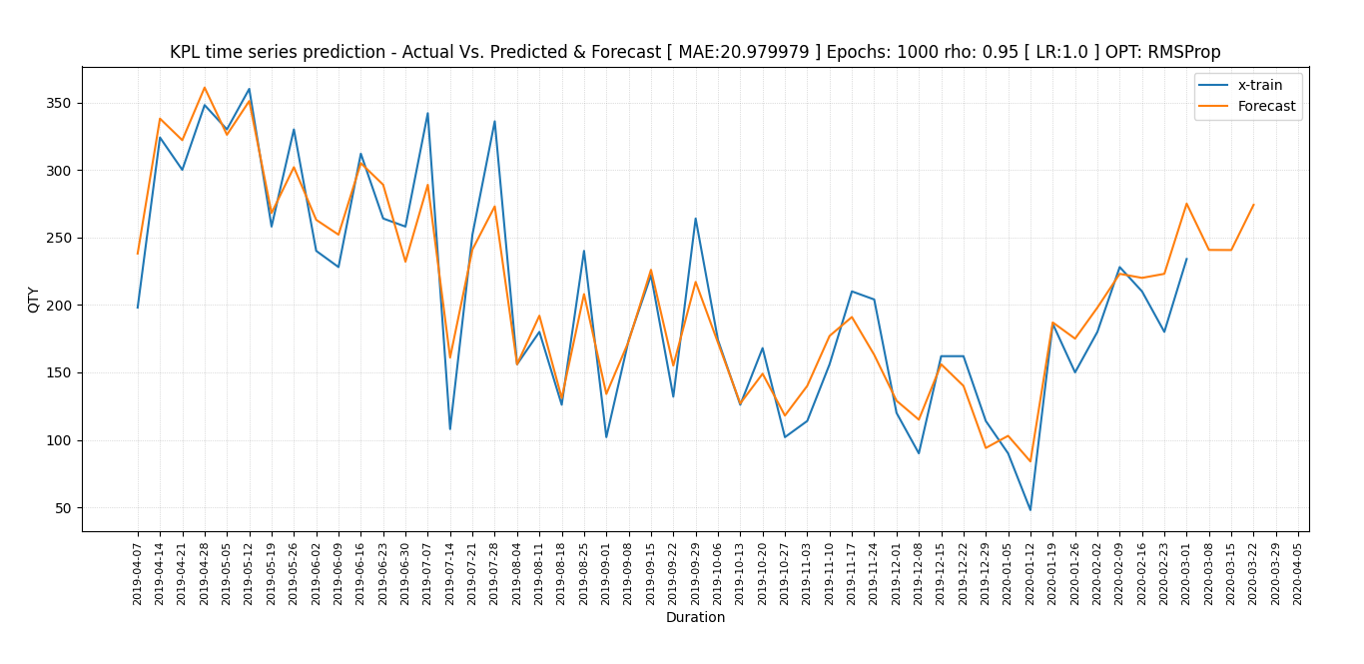
Prediction Window size 3
training | 48
Predicted | 48
forecast | 3
Prediction & Forecast before Covid original data - Window size 3 (Weekly Resample)

Slide 15
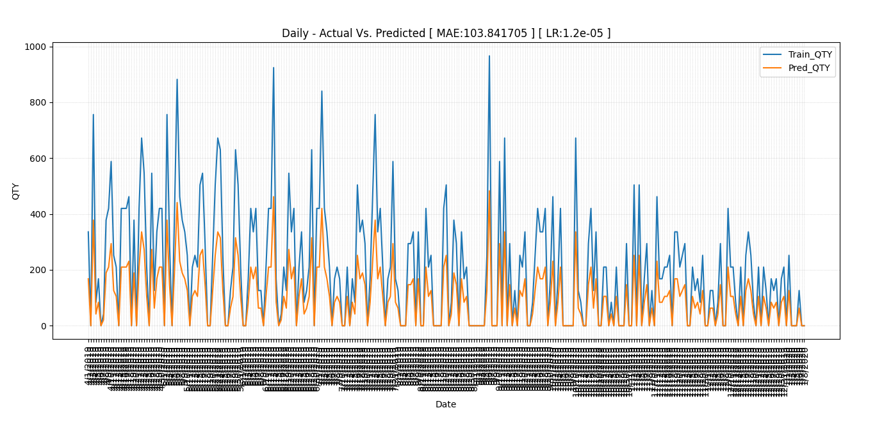
Prediction Window size 1
training | 356
Predicted | 356
Prediction using original data before Covid (DAILY)
3

Slide 16
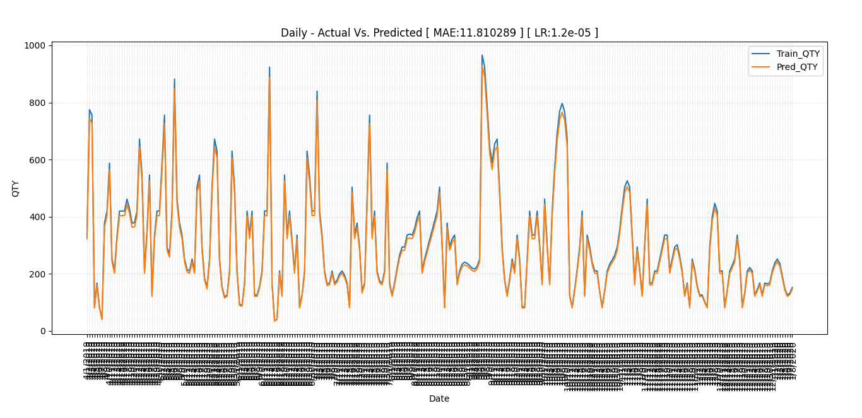
Prediction Window size 1
training | 356
Predicted | 356
Prediction using Akima imputed data before Covid (DAILY)
3

Slide 17
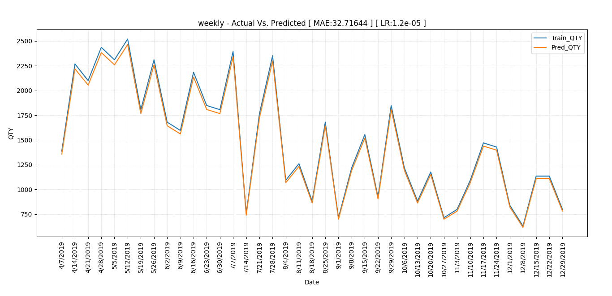
Prediction Window size 1
training | 39
Predicted | 39
Prediction using original data before Covid (Weekly)
3

Slide 18
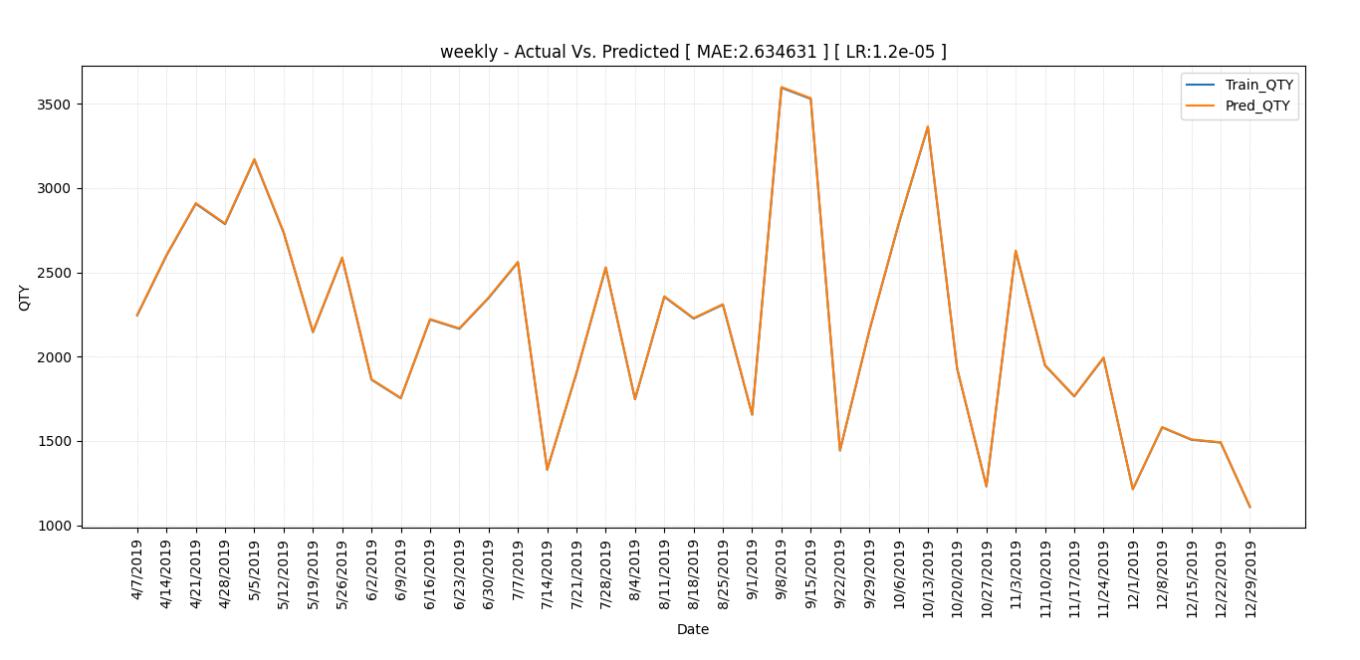
Prediction Window size 1
training | 39
Predicted | 39
Prediction using Akima imputed data before Covid (Weekly)
3

Slide 19
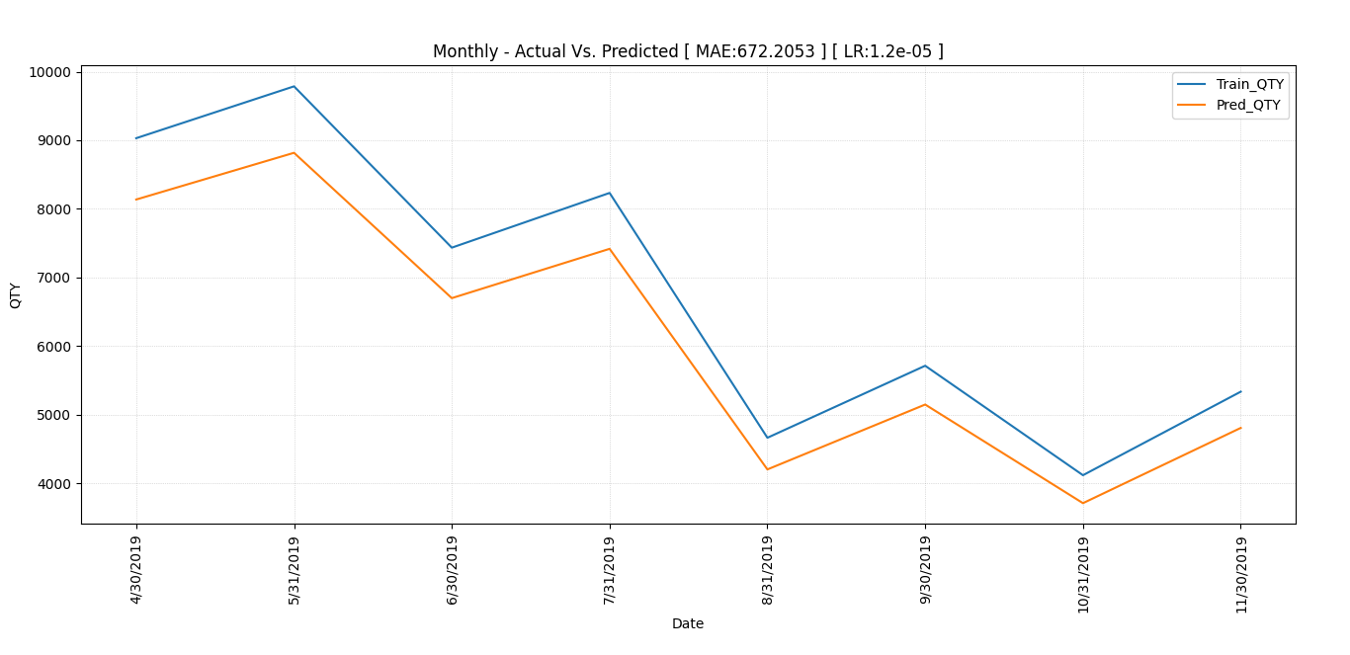
Prediction Window size 1
training | 8
Predicted | 8
Prediction before Covid-Original-Window size 1 (Monthly)
3

Slide 20
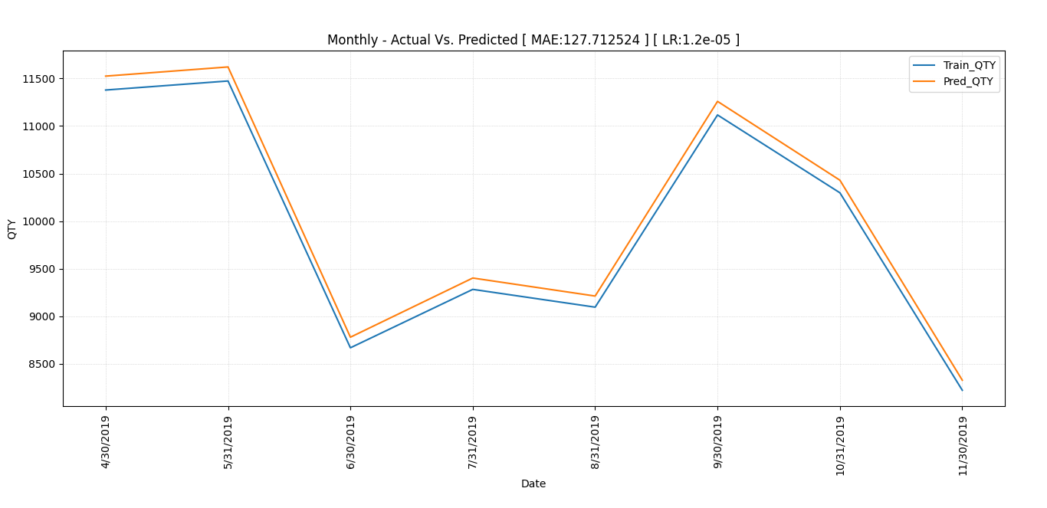
Prediction Window size 1
training | 8
Predicted | 8
Prediction using Akima imputed data before Covid (Monthly)
3

Slide 21
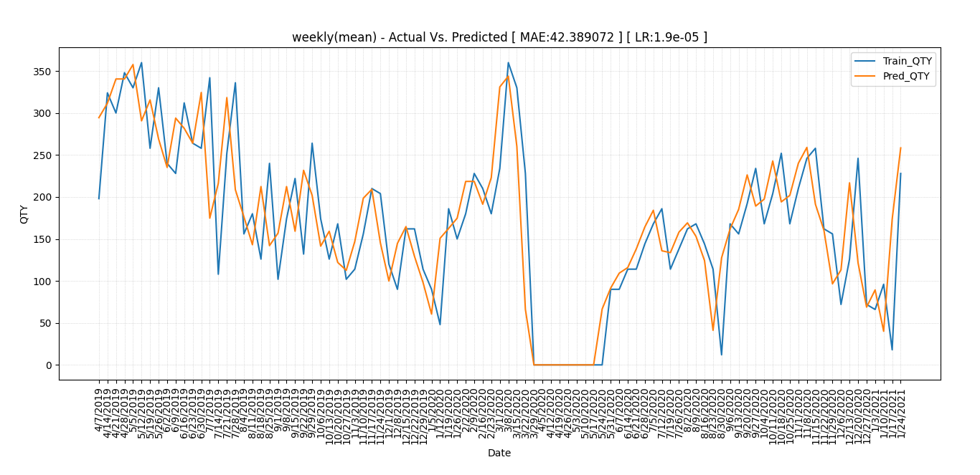
Prediction Window size 2
training | 95
Predicted | 95
Prediction using original data - Window size 2 (Weekly Resample Mean)
3

Slide 22
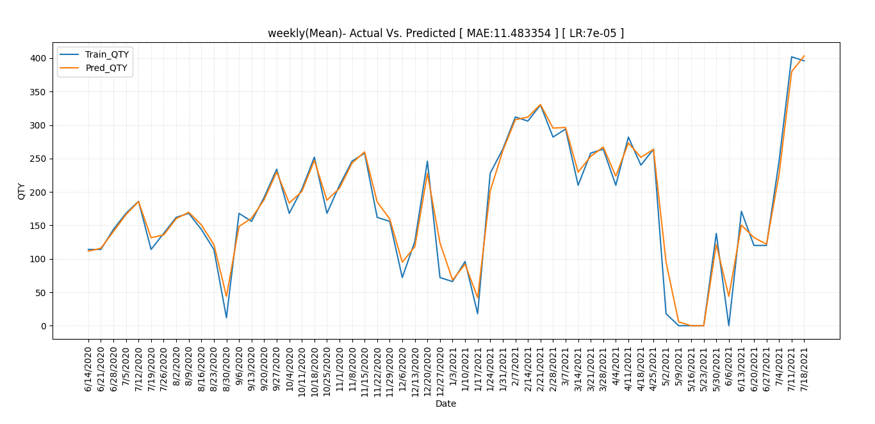
Prediction Window size 2
training | 67
Predicted | 67
Prediction using original data after Covid- Window size-2-mean
3

Slide 23
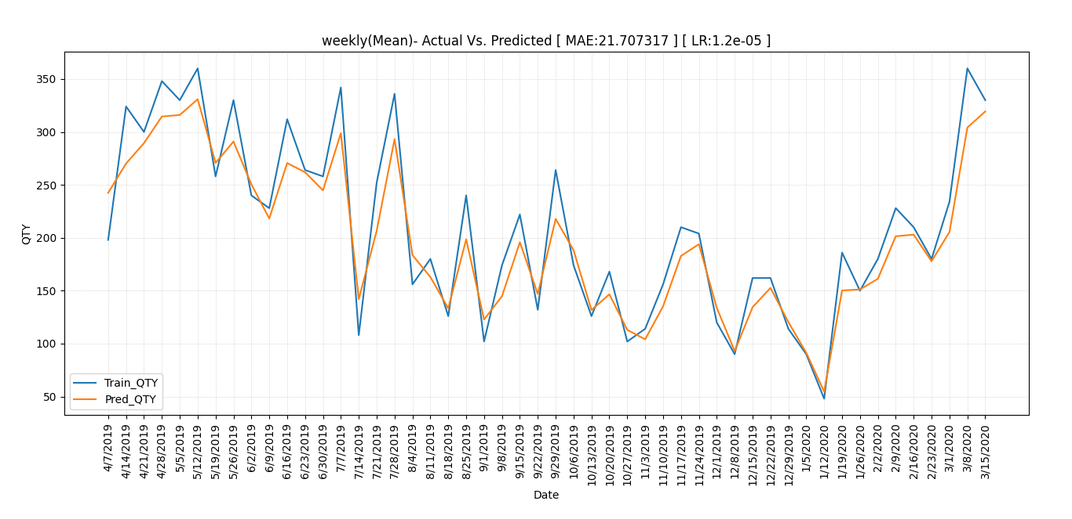
Prediction Window size 2
training | 50
Predicted | 50
Prediction using original data before Covid- Window size-2-mean
3

Slide 24
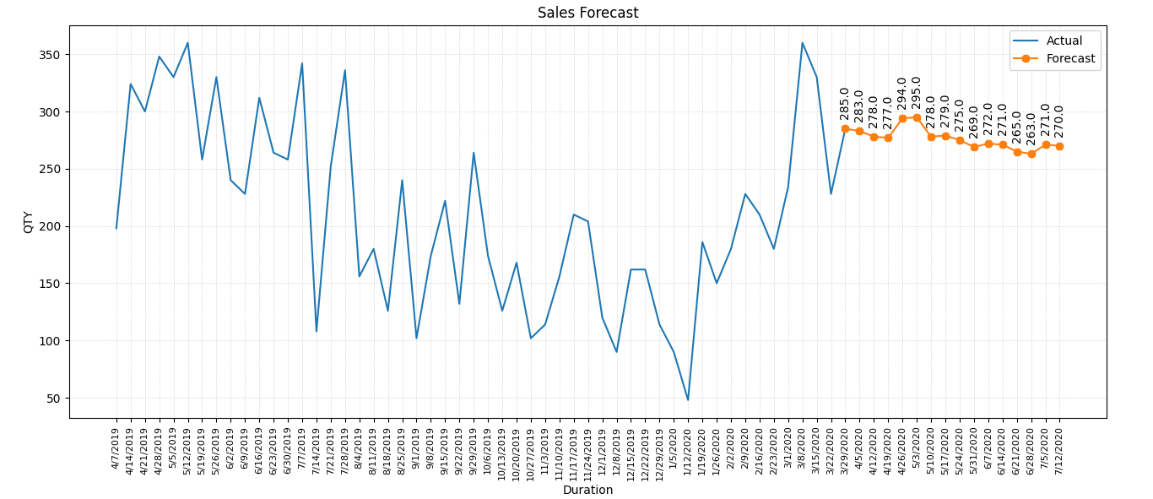
Forecasting Window size 2
51
16(2x)
 | ACT | PRED
avg | 2019 | 2020 | %diff
April | 293 | 283 | 3.41
May | 320 | 279 | 12.81
June | 260 | 267.5 | -2.73
Sales forecasting observation during Covid on (Weekly Resample) with mean data
3

